Slide 1




SCHOLARSHIP OPPORTUNITIES IN AFRICA, ASIA AND MIDDLE EAST
Gafari Lukumon, PhD.
13-07-2024

Slide 2
Outline
Insights from the survey
Benefits of scholarships in middle east, Asia and Africa for Africans
Some scholarship opportunities in these regions
Testimonies

Slide 3
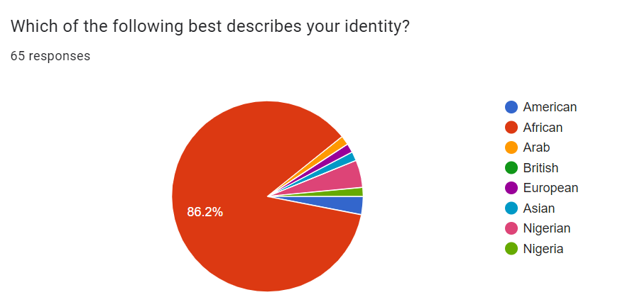
You’re biased!

Slide 4
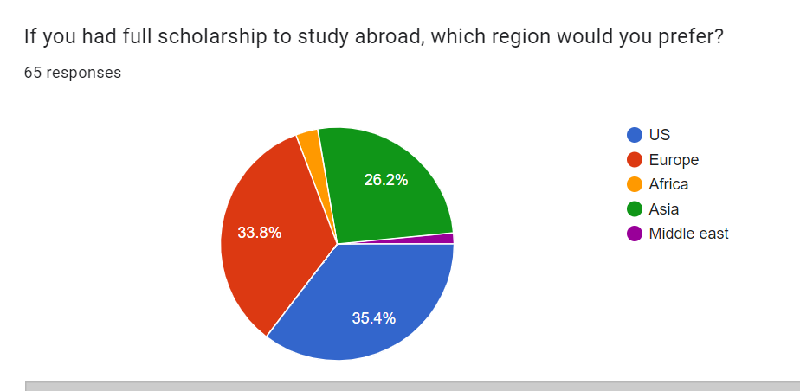
You’re biased

Slide 5



Stem from various factors
Notes:
Prestige/value. Awareness. Quality

Slide 6
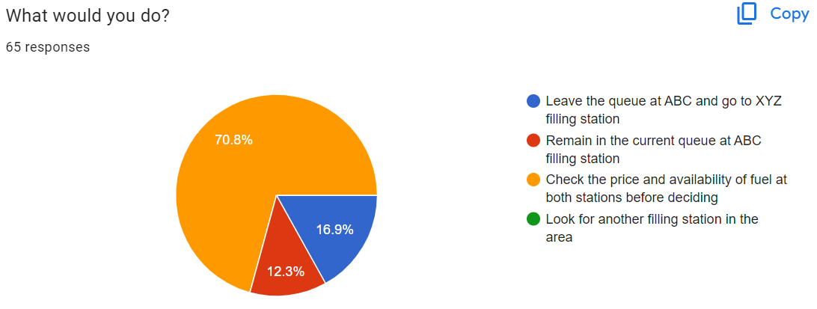

Slide 7


Slide 8

Less competitive

Slide 9

Underrepresented group

Slide 10

Proximity to family

Slide 11

Cotutelle

Slide 12

Cultural experiences

Slide 13

Religion experiences

Slide 14

Scholarship opportunities

Slide 15


Slide 16


Slide 17


Slide 18



Slide 19


Slide 20


Slide 21


Slide 22


Slide 23

Testimonies

Slide 24


Slide 25








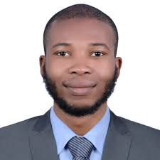




Slide 26


